Slide 1
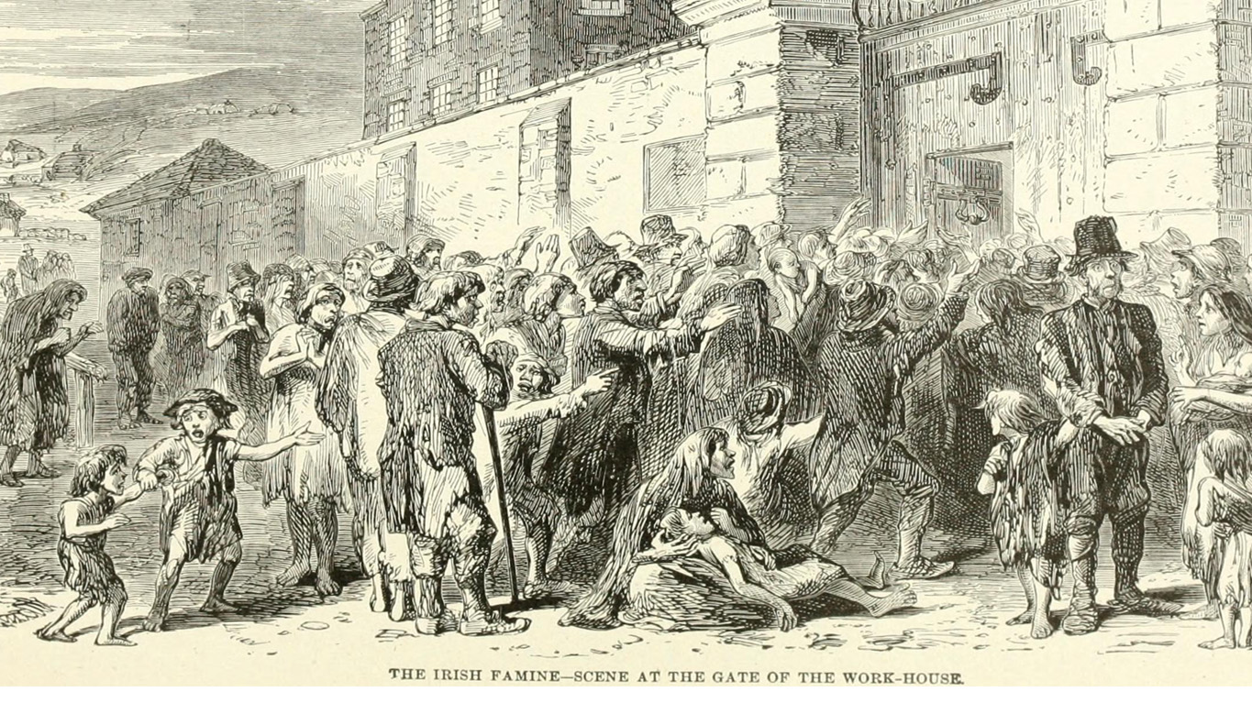
The Great Irish Famine
By Emma and Anthony

Slide 2
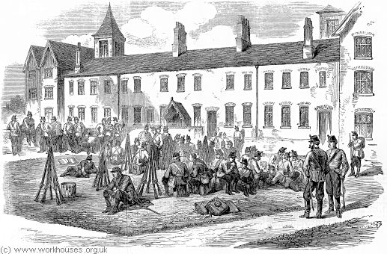
What is the Famine?
The Famine is a thing that happened in the 1800s. It started when Irelands potatoes started to rot. The people were starving to death and some went to the workhouse to get money to feed their family.

Slide 3
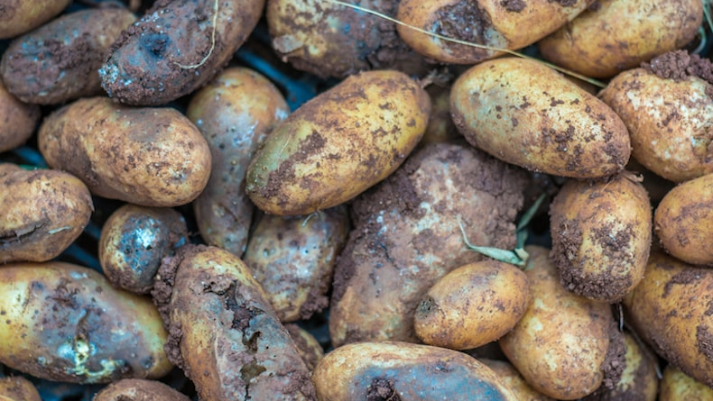
The Blight
The Blight is the fungus that targeted the potatoes. The fungus caused the potatoes to rot. This fungus on them caused the people to starve, this effected nearly the whole of Ireland.

Slide 4
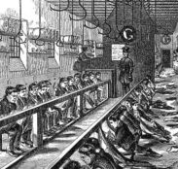
The Workhouse
The workhouse is a place that people went to get money for food. When they entered the work house they couldn’t leave until they died. In the workhouse the men had to build walls and the women had to knit mop clean and make diner.

Slide 5
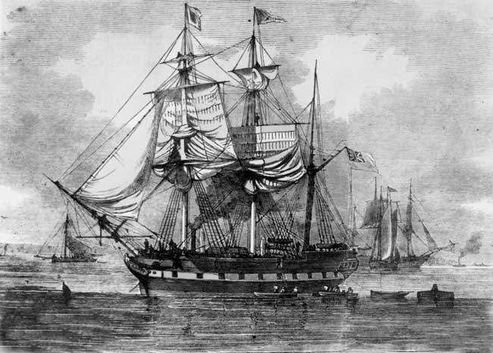
Coffin ships
On coffin ships 1 in 6 people would die. There are lots of people on every coffin ship . People would go on coffin ships to escape the famine. The coffin ships were going to America.

Slide 6
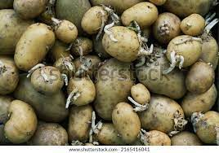
The effects of the famine
Many landlords became bankrupt
Over one million people died of starvation or disease
Workhouses were full of people trying to find food or aid

Slide 7
By Emma and Anthony

